Slide 1

Hook Placement
Divya Muthukumaran, Nirupama Talele, and Trent Jaeger, Vinod Ganapathy and Gang Tan

Slide 2
Contribution
An algorithm for auto-hooking, which:
Minimal authorization hook placement
Satisfy authorization constraints
Constraints satisfy specific access control policies

Slide 3
2. Motivation
Manual hook placement is tedious and incorrect.
Large codebases need retroactive security features.
Need systematic techniques to retrofit legacy code for security
Goal of Authorization Hook Placement: completely mediate all security sensitive operations on shared resources.
This leads to two subgoals:
→ identifies security sensitive operation
→ placement of minimal and effective hooks

Slide 4
3.1 Related Works
There are some former works in:
(1) Manual Hooking:
1.1 X11 ~ proposed 2003, upstreamed 2007, changing to date. [Kilpatrick et al., ‘03]
1.2 Linux Security Modules ~ 2 years [Wright et al., ’02]
(2) Verifying Hook Consistency
2.1 For Kernels [Zhang et al.,2002, Edwards et al., 2002, Tan et al., 2008]
2.2 For Web Applications [Sun et al., 2011, RoleCast 2011, FixMeUp 2012]
(3) Placing Hooks Automatically (People also conduct auto-hooking process, with input of Sensitive Data types and hook code)
3.1 Server Applications [Ganapathy et al., 2005,2006, 2007];

Slide 5
3.2 Related Works
There are some limitations in former works:
(1) Manual Hooking:
Loads of work for programmers
(2) Verifying Hook Consistency
To identifying security sensitive operations, have to specify code patterns or/and security-sensitive data structures manually → former work of Trent, SSO only using sources of untrusted inputs and language specific lookup functions
(3) Placing Hooks Automatically (People also conduct auto-hooking process, with input of Sensitive Data types and hook code)
→ use of low level representation of SSO, such as individual structure member accesses, result in hooks scattering across the whole program, which is hard to maintain and update
→ use of low level representation of SSO, leads to redundant authorization, and is not one to one mapping with placement of domain experts

Slide 6
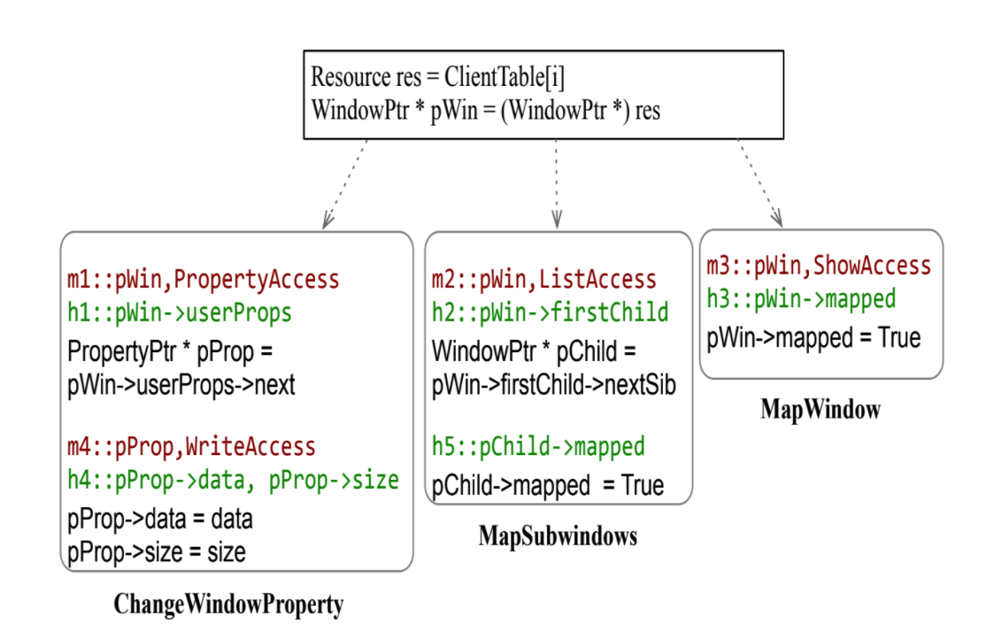
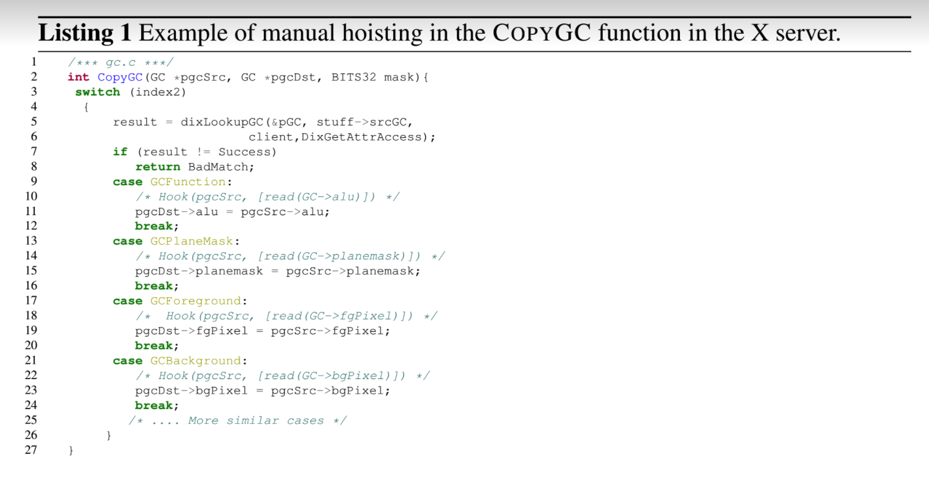
4.1 Methodology: Authorization Hook Placement Problem
Two Main Problems: Find SSO ; Redundant Removal and Redundant Hoisting

Slide 7
4.2 Methodology: Authorization Hook Placement Problem
Two Main Problems:
Granularity of SSO → balancing numbers of hooks placed and least privileges
Redundant Removal and Redundant Hoisting
→ we need more control what can do and can’t do, however not overkill
Idea in this paper: more policy specific auto-hooking strategy

Slide 8
4.3 Methodology: Authorization Hook Placement Problem
Static taint analysis
• Identify variables tainted by user request.
• Identify security-sensitive objects.
Control dependence analysis
• Identify security-sensitive operations.
• Hoist and remove redundant hooks.

Slide 9
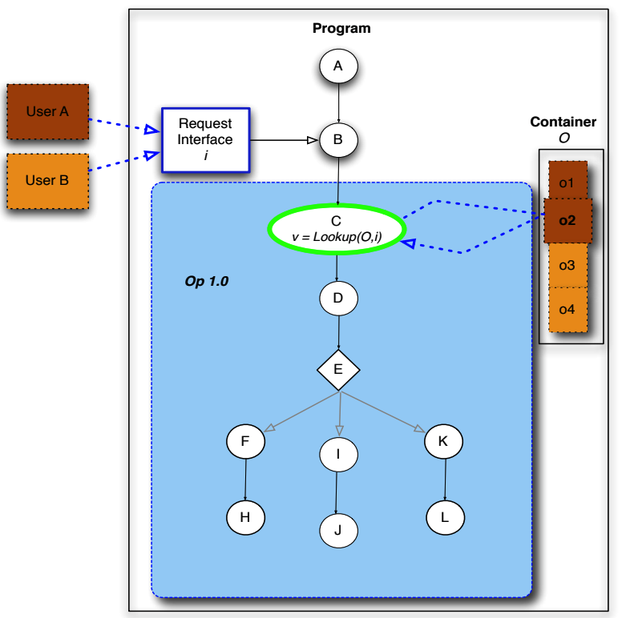
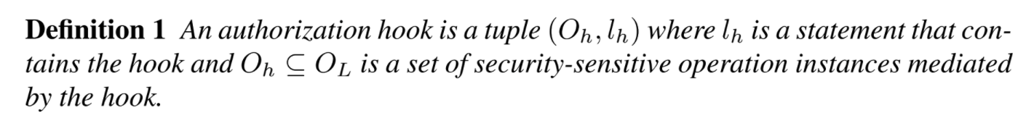
4.3 Methodology: Static Taint Analysis
Static taint analysis
• Identify variables tainted by user request.
• Identify security-sensitive objects.
Stage 0: Get source code and user requests inputs(tainted)
Stage 1: identify security sensitive objects
Stage 2: identify tainted variables
Stage 3: identify user choice operations
Stage 4: identify authorization hook placements

Slide 10
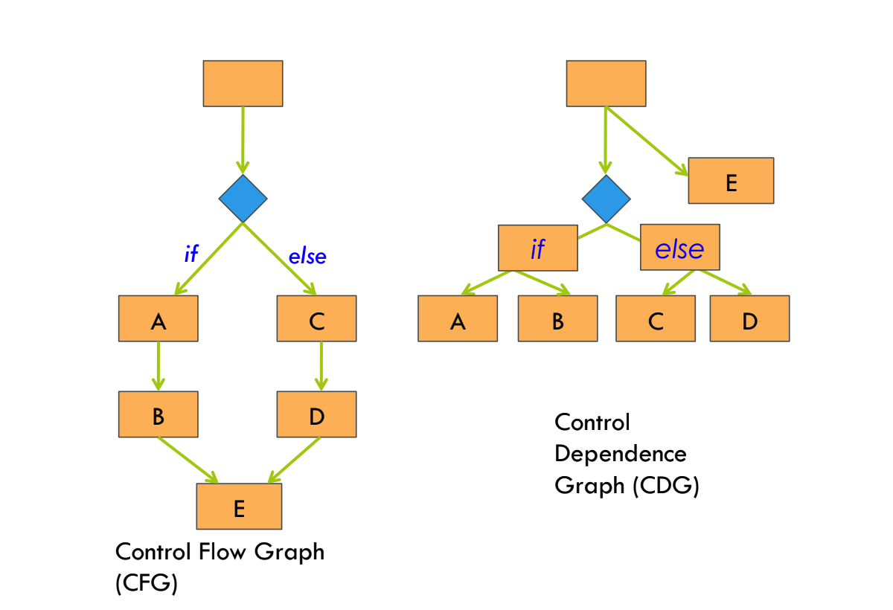
4.4 Methodology: CDG
CDG graph generating
→ dominance tree

Slide 11
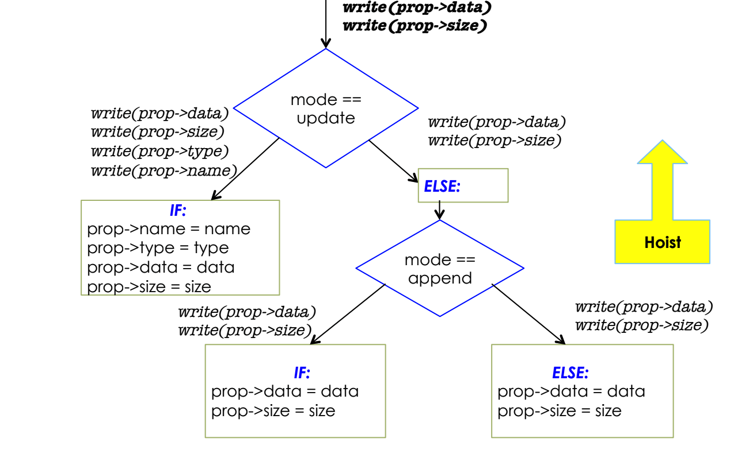
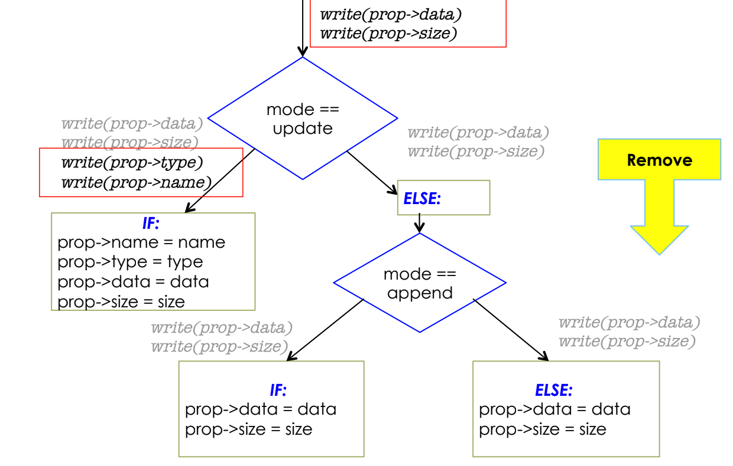

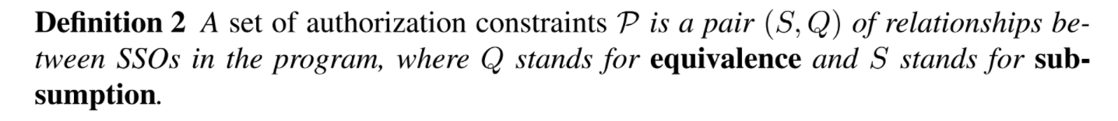
4.5 Methodology: Hoisting and Removal
Constraints Selector:
Equivalence of accesses to SSOs
Constraints Selector:
E.g. MLS, if a subject read a field of a variable also permits read all fields of the variable

Slide 12
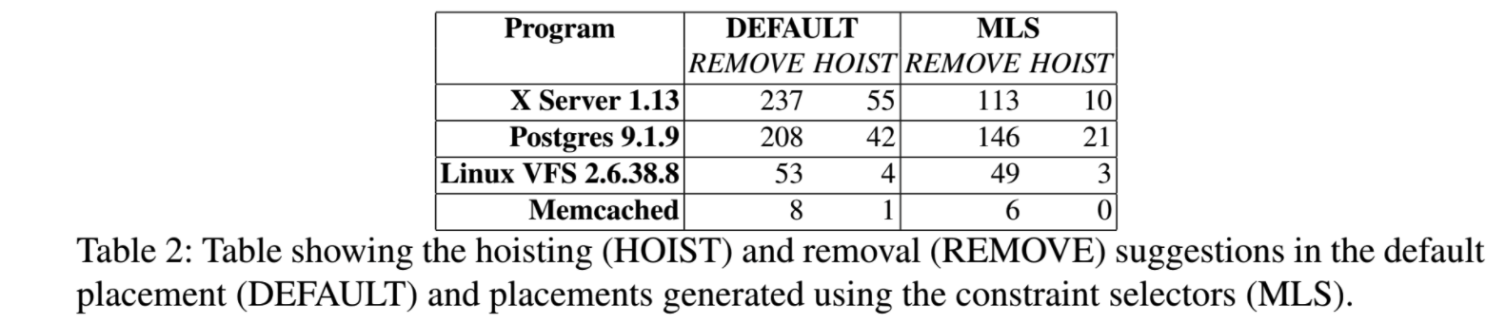
5. Results
a) Does the approach produce placements that are closer to manually placed hooks?
b) Does the approach reduce programmer effort necessary to place authorization hooks?
constraint selectors v.s. Trent former work
Hook number reduced by 30%, as shown below
Constraint selectors reduces the gap between manual and automated placements by 58%
Constraint selectors reduces the programmer effort by 58%

Slide 13
6. Take Away
Pros:
User friendly:
The programmers only have to specify high-level security goals.
Static and Dynamic Analysis helps programmers with constraint selection.
Cons:
This paper does not consider alias analysis, polymorphic type or path sensitive analysis

Slide 14
Thanks!
Q & A

